Slide 1
Presentation on Public Policy Analysis “A Draft on-National Youth Policy-2012”
Chaphekar Prasad Arvind, Monika Yadav, T.Uniel Kichu AO, Divya Vashistha, Anita Sirohiwal, Krishna Kumar Tiwari, Vijay Singh, B.Kumar, Manish Anand, Suneel Pamidi, N. Mohondas Singh

Slide 2
Introduction
Changing demographic profile-Youngest nation
To put young people at the center of country’s growth and development
NYP-To provide direction to youth focussed intervention by government.
To mainstream youth’s needs and concerns into overall national development policy.

Slide 3
Salient Features
Definition of Youth- Age bracket of 16-30
Youth not as a homogenous group
Due to role and responsibilities, sub divided into-
First sub group of age 16-21
The second sub group of age 21-25
The third sub group of age 26-30
Goal- To empower the youth of the nation by bringing holistic development
Development of YDI(Youth Development Index)

Slide 4
Target Groups
Student Youth
Urban Youth in slums and Migrant Youth
Rural Youth
Tribal Youth
Youth At Risk
Youth in violent conflicts
Out of school/dropouts
Groups with social /moral stigma
Youth in Institutional Care.
Priority Group
Young women
Belonging to socially and economically disadvantaged communities
Differently abled youth

Slide 5
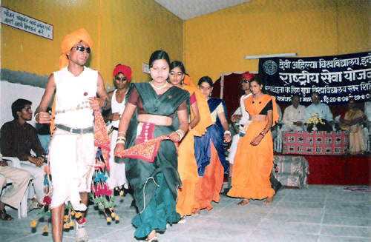
Thrust Areas
Promotion of national values, social harmony, national unity
Empowering youth through employable skills
Education
Health and healthy life style
Sports and recreation
Gender justice
Participation in community service
Social justice and action against unhealthy social practices
Environment issues and
Youth and local governance.

Slide 6
Major Policy interventions
National skill development Corporation
Higher degree of vocational education.
Massive campaigning to tackle female foeticide, domestic violence
Larger role for social entrepreneurship
RGNIYD role

Slide 7
Stakeholders and Implementation issues

Slide 8
Stakeholders
The target population, namely the youth of this country in the group 16-30 years
Ministry of Youth affairs and sports
Ministry of Human resource and development
Ministry of health
Ministry of Labour
Ministry of Women's welfare
Voluntary Organizations

Slide 9
Implementation Issues & Suggestions
Coordination among a large number of ministries and departments
Funding sources are mentioned only briefly
Policy interventions are not according to focus groups
Requires each state to formulate its own youth policy.-time consuming
Incentives should be awarded to states for formulating such a policy, as this is a short term policy
No intervention sugggested for sexual minorities (LGBT)

Slide 10
MERITS
Proposes to change the target age.
Youth not as a homogenous group
The policy is exhaustive and gives a holistic approach and emphasizes integration with the mainstream development.
Youth Development Index (YDI)- baseline for evaluators and policy makers

Slide 11
MERITS…
Specifies a large number of target groups of youth including students, slum dwellers etc.
Policy implementation to be at state level.
Emphasis on youth belonging to the socially and economically disadvantaged communities and groups, and differently-abled persons.
Importance of youth in economic and social development
Provide employable skills to different youth segments

Slide 12
Demerits
The targets groups –students ,rural youth ,targets of social stigma have not been mapped correspondingly with thrust areas like education , health, career.
Groups are rigidly defined and may lead to ignorance of certain issues. Target groups not exclusive e.g. may need both education and health
Policy advocates continuation of NSDC which has underperformed till date.
Policy does not focus on national unity promotion .
The preoccupation of this ministry might be with sports, and non-sports matters of youth might have a secondary status.

Slide 13
International perspectives
UNESCO Guidelines:
Policy formulation, implementation, monitoring & evaluation, capacity building & training.
Broad strategic goals, priority areas, action plans
Education, employment, poverty, health, environment, drug abuse, AIDs, IT, conflict prevention, intergenerational relation etc.

Slide 14
Contd…
United Kingdom ‘Youth Policy’
Statistics, legislation, national programmes, budget
Brazil ‘Statute of Youth’
Seven years deliberation in the Federal Chamber
Culture, media, employment, ‘Youth Councils’
Australia Youth Ministry
Comprehensive policy covering health, education & work, community, environment, finances.

Slide 15
Conclusions
Good initiative taken by ministry of youth affairs and sports.
Concerned departments and ministries have to work with the unique objective for success
Proper care should be taken in order to avoid delays
Dire need to work for the fulfillment of the objective of the policy

Slide 16
THANK YOU

